Slide 1
Indispensable, Disposable Jenkins
Mandy Hubbard, London, 20 October 2017

Slide 2
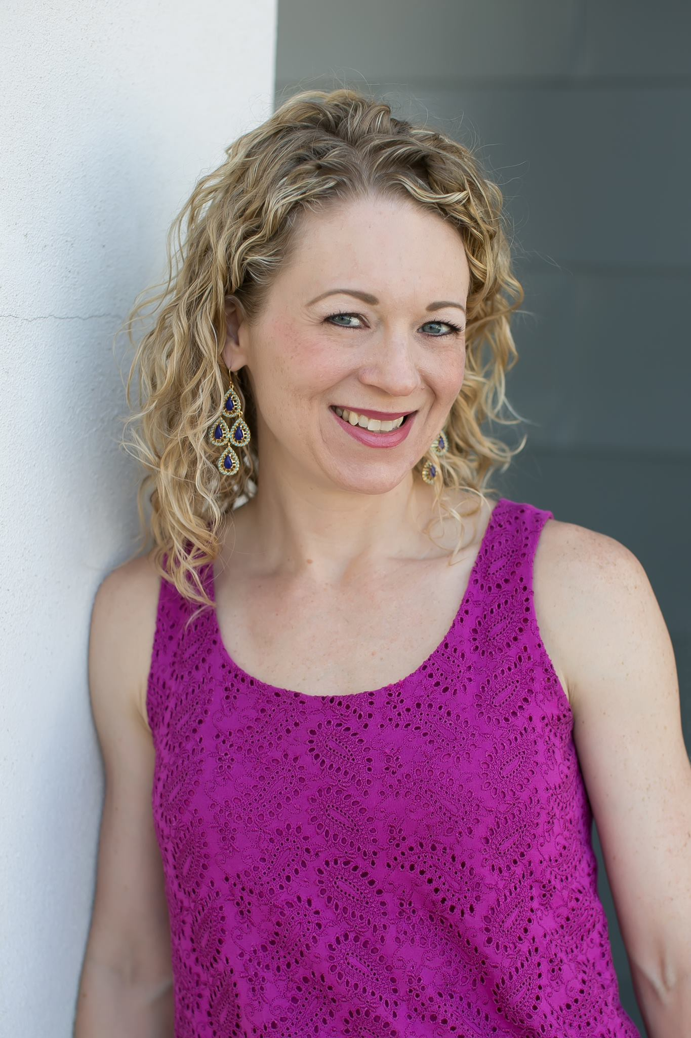
import "me"
Mandy Hubbard
QA Architect, Care.com Homepay
@DevMandy

Slide 3


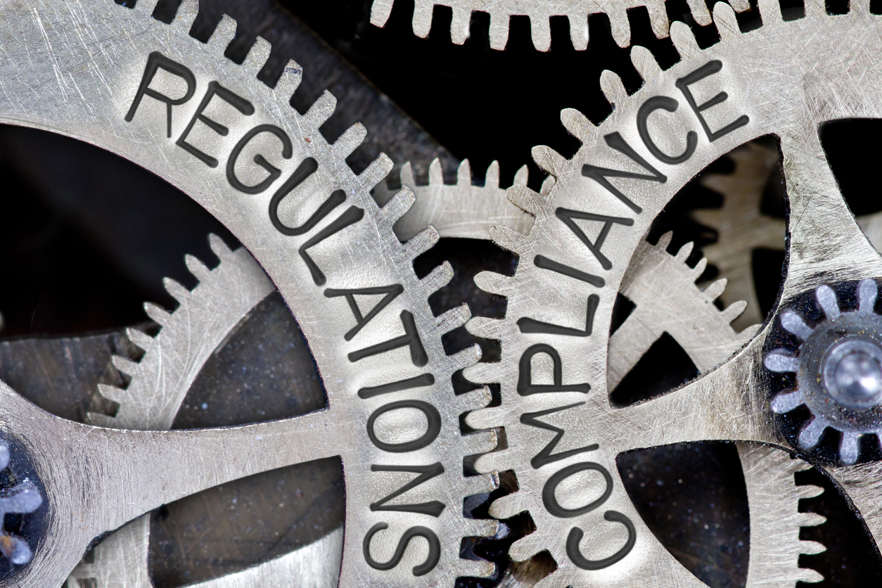
Notes:
World’s largest online platform for finding and managing family care
Largest provider of payroll and tax services for household employees – caregivers -- in all 50 states.
25 years
Innovating
A lot at stake
Two tasks
For this I chose Jenkins

Slide 4
Quality as a Service
“Quality is not an act, it is a habit.”
— Aristotle
Notes:
Release in a reliable manner
Reduce regression
Process not testing at the end
Minimize merge conflicts
Continuous Integration
Continuous Delivery
Business cares about quality? Why? Fast

Slide 5
Canonical Analogy Time
Q: Why do cars have brakes?
A: So they can go fast.
A: So they can go fast!
Notes:
Full throttle
Stop reliably
Confidently release code fast
Lightening speeds
Edge of safety
Transition: Fortunately, release quality software is simple, right?

Slide 6


Developer Friendly Quality Software Process
Upstream Master
(Pull Requests)
(Trigger)
Auto
build and
test

Slide 7
GitHub Process Flow
2
Dev A
(local)
Dev A’s
Fork
(origin)
1
GitHub
Clone
Fork
Organization
master
(upstream)
3
4
Push
PR
Dev B
(local)
Dev B’s
Fork
(origin)
Fork
Clone
PR
Push

Slide 8
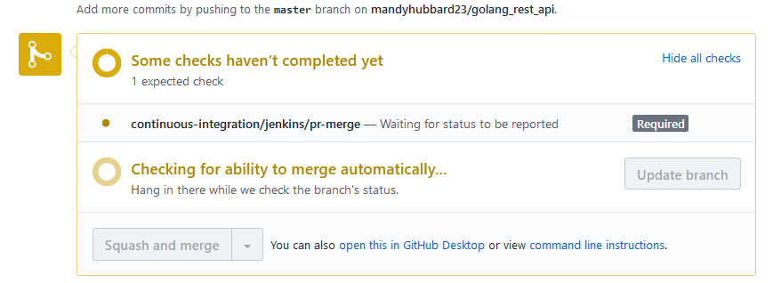
Continuous Integration
5
Dev A’s
Fork
(origin)
4
Upstream
PR
Build/Test
Build Status
6

Slide 9
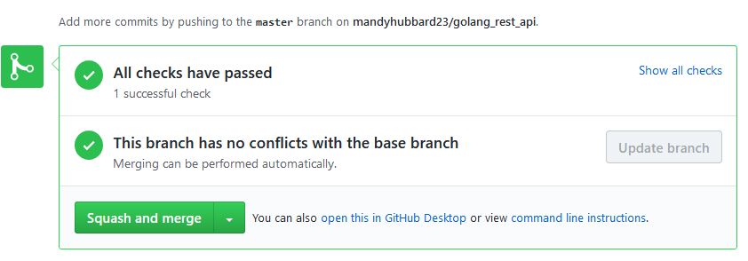
Continuous Delivery
7
push
Build/Test
Upstream
Webhook Event
Release
8
9

Slide 10
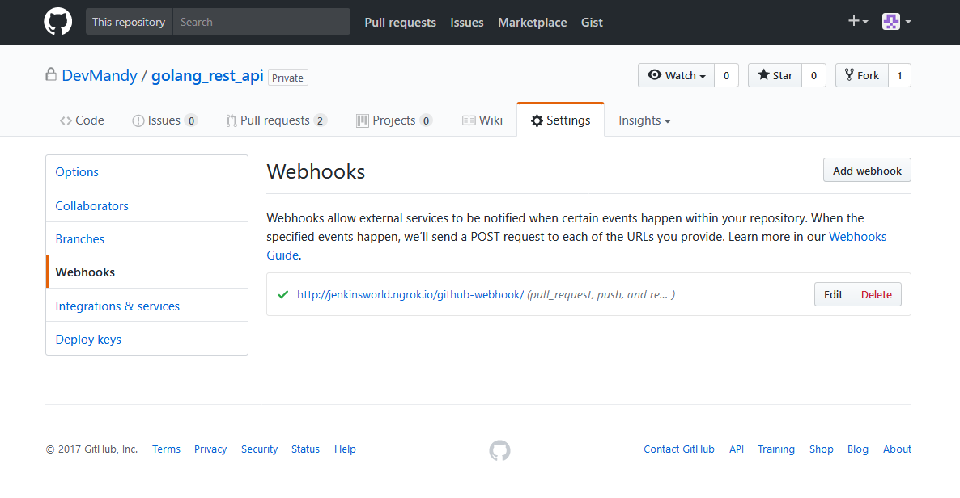
GitHub Webhook Configuration

Slide 11
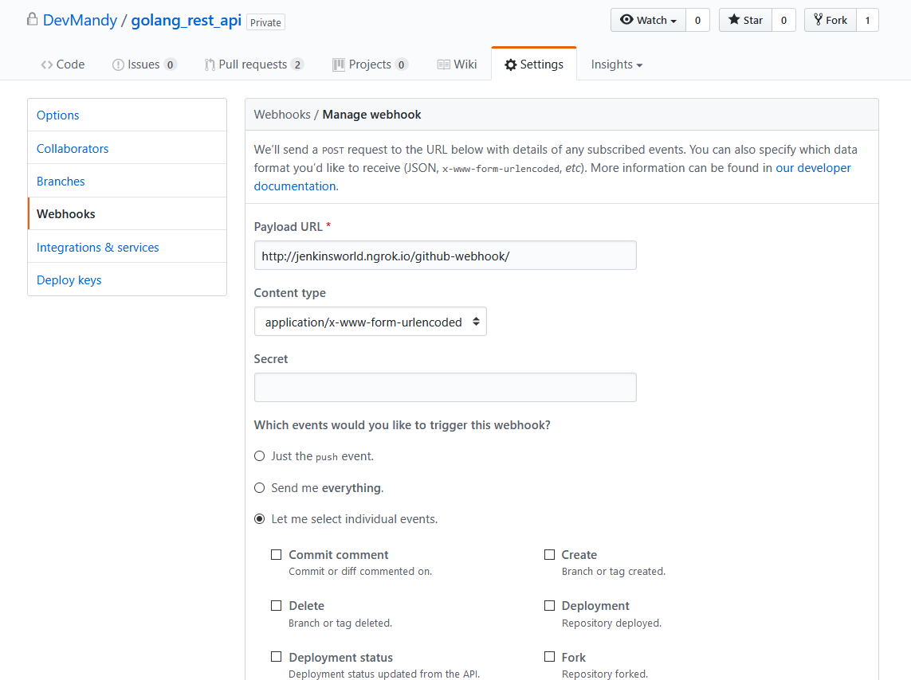
GitHub Webhook Configuration

Slide 12
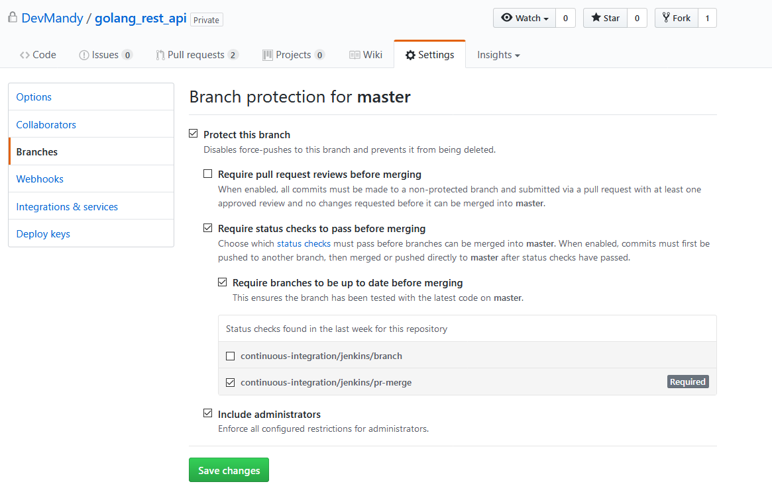
Protected Branch

Slide 13
Demo Time
Notes:
What does this look like?
How does my team use Jenkins every day?
Let’s look at how Jenkins is indispensable to our continuous deliver process.
Do you see what we’ve done here?

Slide 14
Technology Stack
Docker
ContainerPilot
Consul
Docker Compose

Slide 15
Container Processes
PreStart
Jenkins
Health
Health
Task
Task
ContainerPilot
Consul Agent

Slide 16
Docker Compose Environment File
LDAP_SERVER=openldap
LDAP_ROOT_DN=dc=devmandy,dc=org
LDAP_MANAGER_DN=cn=admin,dc=devmandy,dc=org
LDAP_MANAGER_PASSWORD_SECRET=password
LDAP_USERNAME=mandy
LDAP_PASSWORD=password
GITHUB_TOKEN=305fa17c9af90d1351541357528a5c49592d4260
GITHUB_USERNAME=devmandy
GITHUB_ORGANIZATION=DevMandy
GITHUB_CREDENTIALS_ID=github
DOCKERHUB_ORGANIZATION=devmandy
DOCKERHUB_USERNAME=devmandy
DOCKERHUB_PASSWORD=password
DOCKER_REGISTRY=https://index.docker.io/v1/
DOCKERHUB_CREDENTIALS_ID=dockerhub
DOCKER_HOST=tcp://10.0.2.15:2375
…
LDAP_SERVER=openldap
LDAP_ROOT_DN=dc=devmandy,dc=org
LDAP_MANAGER_DN=cn=admin,dc=devmandy,dc=org
LDAP_MANAGER_PASSWORD_SECRET=password

Slide 17
Anatomy of a Plugin
<plugin="docker-plugin@0.16.1-SNAPSHOT">
<scope>GLOBAL</scope>
<id>unique-id</id>
<description>Triton Certificates</description> <path>/var/jenkins_home/.sdc/docker/jenkins</path>
</com.nirima.jenkins.plugins.docker.utils.DockerDirectoryCredentials>
Read / Write
Jenkins UI
Config.xml
config.xml

Slide 18
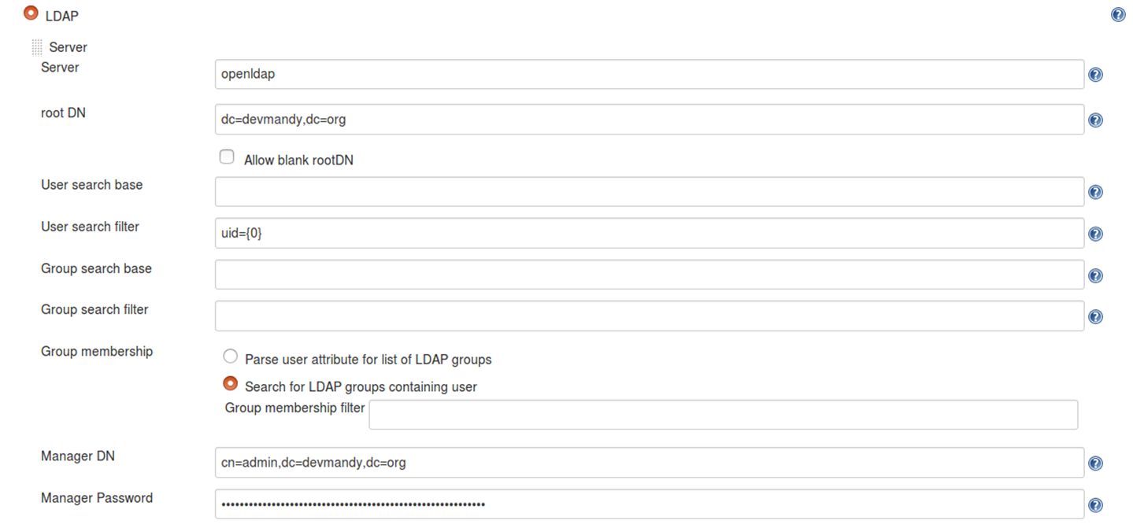
LDAP Plugin UI

Slide 19
Configuration File
<securityRealm class="hudson.security.LDAPSecurityRealm" plugin="ldap@1.16"> <jenkins.security.plugins.ldap.LDAPConfiguration> <server>ldap-server</server> <rootDN>root-dn</rootDN> <inhibitInferRootDN>false</inhibitInferRootDN> <userSearchBase></userSearchBase> <userSearch>uid={0}</userSearch> <groupMembershipStrategy class="jenkins.security.plugins.ldap.FromGroupSearchLDAPGroupMembershipStrategy"> <filter></filter> </groupMembershipStrategy> <managerDN>manager-dn</managerDN> <managerPasswordSecret>password</managerPasswordSecret> <displayNameAttributeName>givenName</displayNameAttributeName> <mailAddressAttributeName>mail</mailAddressAttributeName> </jenkins.security.plugins.ldap.LDAPConfiguration> </securityRealm>
<server>ldap-server</server> <rootDN>root-dn</rootDN>
<managerDN>manager-dn</managerDN> <managerPasswordSecret>password</managerPasswordSecret>

Slide 20
Docker Compose Environment File
LDAP_SERVER=openldap
LDAP_ROOT_DN=dc=devmandy,dc=org
LDAP_MANAGER_DN=cn=admin,dc=devmandy,dc=org
LDAP_MANAGER_PASSWORD_SECRET=password
LDAP_USERNAME=mandy
LDAP_PASSWORD=password
GITHUB_TOKEN=305fa17c9af90d1351541357528a5c49592d4260
GITHUB_USERNAME=devmandy
GITHUB_ORGANIZATION=DevMandy
GITHUB_CREDENTIALS_ID=github
DOCKERHUB_ORGANIZATION=devmandy
DOCKERHUB_USERNAME=devmandy
DOCKERHUB_PASSWORD=password
DOCKER_REGISTRY=https://index.docker.io/v1/
DOCKERHUB_CREDENTIALS_ID=dockerhub
DOCKER_HOST=tcp://10.0.2.15:2375
…
LDAP_SERVER=openldap
LDAP_ROOT_DN=dc=devmandy,dc=org
LDAP_MANAGER_DN=cn=admin,dc=devmandy,dc=org
LDAP_MANAGER_PASSWORD_SECRET=password

Slide 21
Jenkins Environment Variables
jenkins@b10065bda8f4:/$ printenv | grep LDAP
LDAP_ROOT_DN=dc=devmandy,dc=org
LDAP_MANAGER_PASSWORD_SECRET=password
LDAP_SERVER=openldap
LDAP_MANAGER_DN=cn=admin,dc=devmandy,dc=org

Slide 22
first-run.sh
'//jenkins.security.plugins.ldap.LDAPConfiguration/server' \ -v ${LDAP_SERVER} \ -u '//jenkins.security.plugins.ldap.LDAPConfiguration/rootDN' \ -v ${LDAP_ROOT_DN} \ -u '//jenkins.security.plugins.ldap.LDAPConfiguration/managerDN' \ -v ${LDAP_MANAGER_DN} \ -u '//jenkins.security.plugins.ldap.LDAPConfiguration/managerPasswordSecret' \ -v ${LDAP_MANAGER_PASSWORD_SECRET} \ ${JENKINS_HOME}/config.xml

Slide 23
ContainerPilot Prestart Config
{ "consul": "http://localhost:8500", "preStart": "/usr/local/bin/first-run.sh", "stopTimeout": 5, . . . }

Slide 24
Summary: Do Try This at Home
Quality makes the business go fast
Jenkins automates our pipeline so we can go fast
Jenkins is critical
Software-define your Jenkins!

Slide 25
Q&A
Thanks for attending!
Contact:
Mandy.Hubbard@yahoo.com @DevMandy
I encourage your questions and feedback

Slide 26
Additional Resources
https://github.com/autopilotpattern/jenkins
https://jenkins.io/blog/2017/07/17/speaker-blog-care/
https://www.joyent.com/containerpilot

